Slide 1

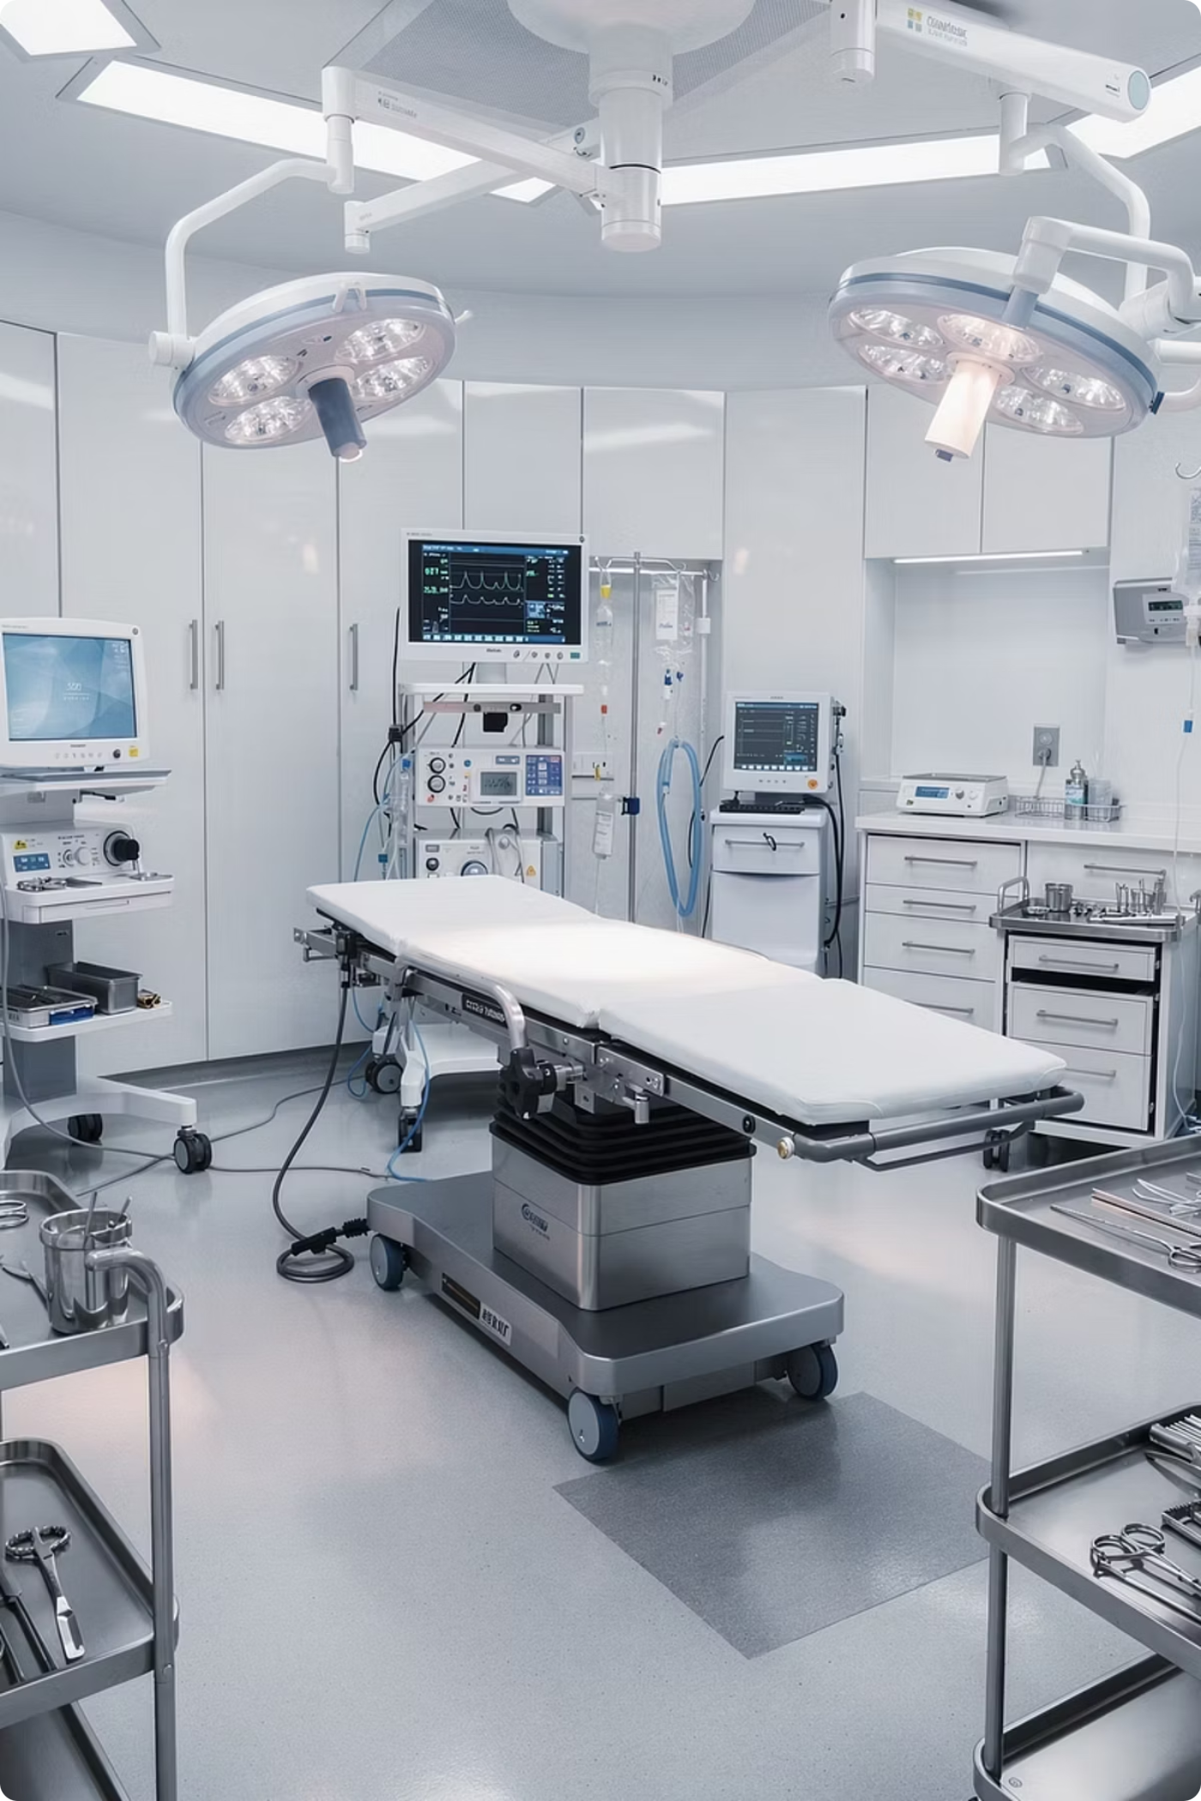
OPERATIONAL AUDIT & STRATEGIC RECOMMENDATIONS
Operation Theatre: Clarification, Gap Analysis, Benchmark & Best Practices
VPS Lakeshore Hospital | FY 2025–26

Slide 2
Agenda
This audit covers five structured domains — from defining the methodology to delivering actionable strategic recommendations for OT excellence at VPS Lakeshore.
Objective, Scope & Methodology
Audit framework, domains, and approach
OT Utilization Analysis
Theatre-wise and specialty-wise benchmarking
Peak Hour Utilization
High-demand windows and capacity stress points
Gap Identification & Recommendations
Bottlenecks, root causes, and action plans
Strategic Overview & Key Focus Areas
Priority actions for OT excellence

Slide 3
Objective & Scope
To conduct a comprehensive audit of OT services with a focus on clinical quality, patient safety, operational efficiency, and process compliance — identifying system gaps and delivering strategic, actionable recommendations for FY 2025–26.
Surgical Safety Checklist
Sterilization & Asepsis
Scheduling & Workflow
Turnaround Time
Inter-procedure intervals and theatre reset efficiency
WHO checklist adherence across all theatres
Disinfection, aseptic practice, and infection control
OT scheduling, utilization, and patient flow
Manpower & Role Clarity
Staffing ratios, deployment, and responsibility alignment

Slide 4

Methodology
A structured, five-phase approach was applied to assess the current state of OT operations and build an evidence-based path to improvement. Each phase builds on the previous, ensuring findings are clinically and operationally grounded.
Assessment
Cause Analysis
Data gathering and site observation
Map root causes and contributors
Gap Identification
Action Plan
Prioritize recommendations
Document variances from standards
Findings are cross-referenced with national and international OT benchmarks, NABH standards, and best-practice frameworks to ensure recommendations are both credible and implementable.

Slide 5
OT Utilization — Key Metric
23.55%
Utilization Formula
OT Utilization % = (Total OT Used Time ÷ Total Available OT Time) × 100
Overall OT Utilization
FY 2025–26 baseline across all theatres — well below benchmark
Parameter
Detail
OT 1–8, 11, 12
24 hrs/day
OT 9 and 10
8:30 AM–7:30 PM
Utilized Time
Room occupied time
Emergency Hours
Included

Slide 6

Overall Utilization — FY 2025–26
Month-wise analysis shows consistently low OT utilization across all theatres in FY 2025–26. At 23.55%, performance is critically below the 70–80% industry benchmark.
23.55%
12
OT Utilization
OT Theatres
Across all theatres, FY 25–26
OT 1–12 under assessment
~70%
3x
Benchmark Target
Improvement Needed
Industry standard for high performance
Utilization must triple to meet target
Critical Alert: Overall utilization at 23.55% is well below the 70–80% industry standard and requires immediate intervention.

Slide 7

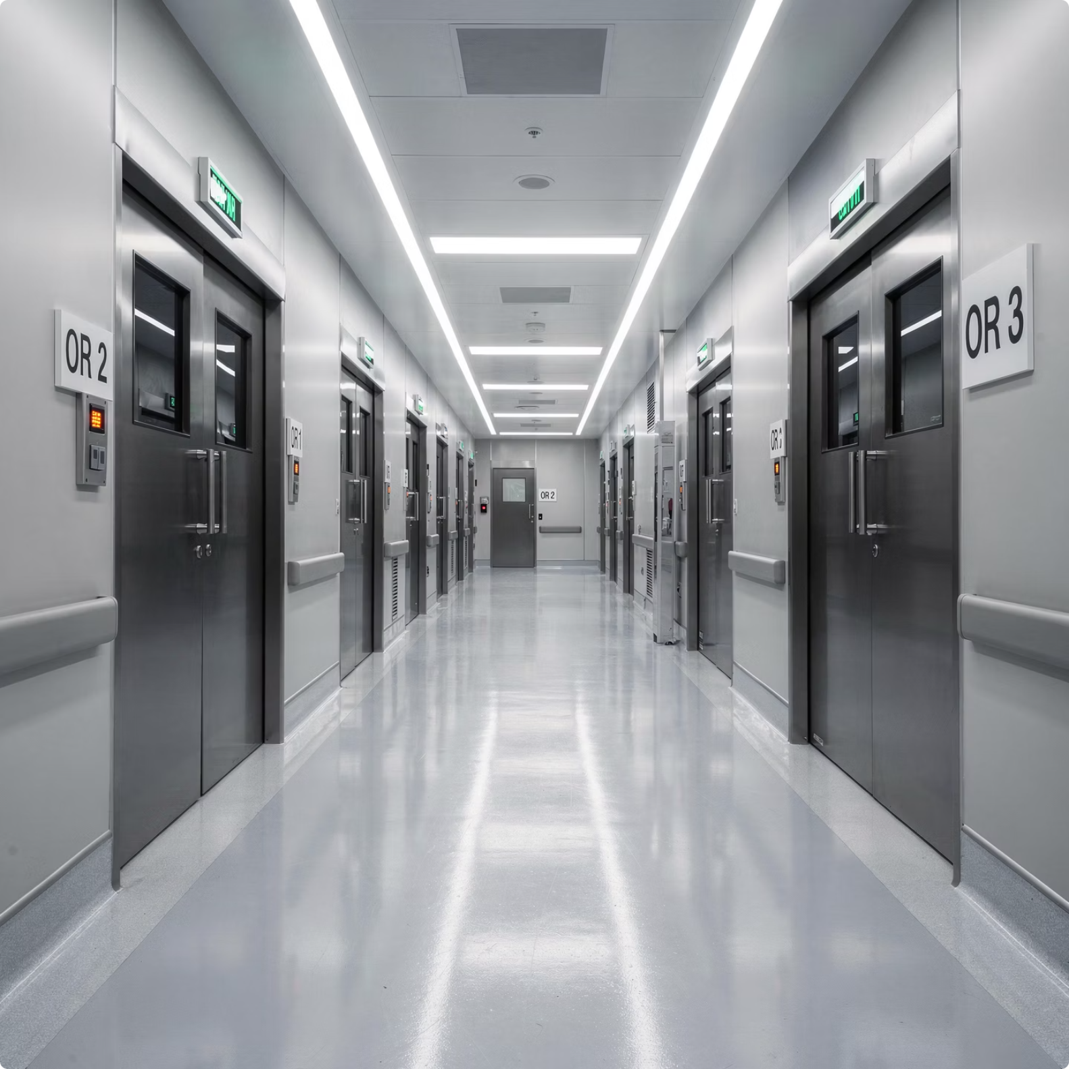
Theatre-wise Utilization
Analysis of total case count and time-based utilization per theatre shows uneven workload distribution across the facility.
OT 9 & OT 10 — Restricted Hours
Key Finding: Theatre allocation imbalance is driving systemic inefficiency. Specialty-to-theatre mapping should be data-driven.
8:30 AM–7:30 PM schedule, but higher utilization per hour suggests better scheduling.
OT 1–8, 11, 12 — 24-Hour Theatres
Full-day availability yet low utilization, pointing to posting and allocation inefficiencies.
Priority Recommendation
Rebalance theatres using specialty demand, case volume, and procedure complexity data.

Slide 8



Specialty-wise Utilization — Case Numbers & OT Hours
Case Volume by Specialty
OT Hours Consumed
High-volume specialties — including Orthopedics, General Surgery, and Gynecology — account for most case numbers.
Lower-volume specialties remain underutilized, indicating room to improve scheduling and capacity planning.
Cardiothoracic, Neurosurgery, and Robotic procedures consume longer OT hours per case.
Dedicated time-blocking and team rostering can improve throughput without disrupting elective lists.
Specialty-wise data visualization to be populated with extracted HMIS data from Ellider. Analysis shown reflects current audit findings and clinical observation.

Slide 9
Peak Hour Utilization — Daily Demand Pattern
Analysis of hourly OT occupancy patterns reveals that most elective cases cluster in the mid-morning window, while early morning and afternoon slots remain underutilized.
Early Morning (6–8 AM)
1
Low utilization. Pre-op prep and team assembly phase with room for first-case gains.
2
Peak Window (8–10 AM)
High demand spike. Multiple specialties compete for theatre access, creating bottlenecks.
Mid-Morning (10 AM–1 PM)
3
Primary elective window, but still below the level implied by peak demand.
4
Afternoon/Evening (1 PM–Night)
Demand falls toward emergency-only caseload. Significant capacity remains available.
Addressing this clustering through structured, staggered scheduling can unlock substantial latent capacity within existing resource constraints — without additional capital expenditure.

Slide 10

Specialty Peak Hour Utilization (8–10 AM)
The 8:00–10:00 AM window is the most contested time slot, with multiple specialties competing for theatre access simultaneously. This creates bottlenecks at pre-op, anaesthesia clearance, and theatre entry — delaying first-case start and compressing the operative window.
General Surgery
Orthopedics
Highest early-morning concentration. Frequent conflicts with Orthopedics require priority in the 8–9 AM slot.
Long cases amplify congestion. Early start is critical to avoid delays that cascade through the day.
Gynecology & Obstetrics
Pediatric Surgery
AM elective cases dominate. LSCS procedures need dedicated priority lanes to avoid list conflicts.
NPO-sensitive cases need first-morning prioritization. Delays increase patient safety risk.
Action Required: Implement specialty-specific time-block scheduling to stagger demand and eliminate concurrent theatre competition during the 8–10 AM window.

Slide 11
Current Bottlenecks & Process Inefficiencies
Six systemic bottlenecks were identified during the audit — each contributing independently to low utilization, operational disruption, and patient safety risk.
Scheduling Discrepancies
Digitalization Deficit
Ad hoc posting and late additions disrupt planned theatre workflow.
Manual records and non-standard documentation reduce traceability and audit readiness.
OT List Finalization Delays
Robotic Asset Underutilization
Lists are finalized too late for adequate prep, consent, and NPO confirmation.
Robotic systems are underused, limiting case volume and clinical ROI.
Information Flow Gaps
Committee Follow-Up Gaps
Delayed coordination between teams causes avoidable first-case delays.
Action items are not tracked to closure, so issues recur without accountability.

Slide 12

Strategic Action Plan
PRIORITY RECOMMENDATIONS
Ellider-Based Scheduling Protocol
OT List Preparation Protocol
Post cases using real-time theatre availability in Ellider
Include expected duration and instrument list for every case
Prioritize cases by Anaesthesia HOD/OT Manager; pediatric and clean cases first
Assign theatre allotment ownership to the anaesthetist or OT Manager
Post elective cases 72–48 hours before the operative date
Lock the final OT list 24 hours before surgery for emergencies
Shift patients to pre-op only after Financial and PAC clearances are confirmed
Confirm communication to nursing, anaesthesia, and surgical teams at list lock
Expected Impact: Full implementation is projected to reduce first-case delay by 40–60% and increase effective scheduling density within the first 90 days.

Slide 13
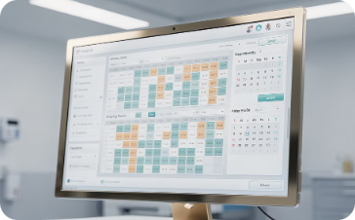
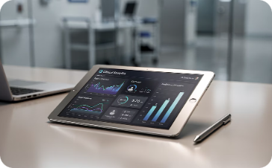
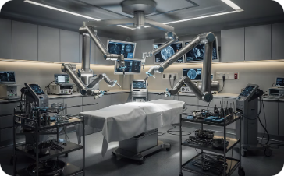
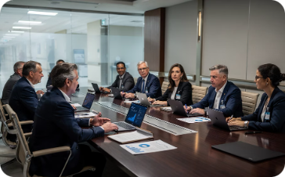
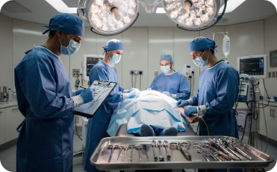
Key Focus Areas for OT Excellence
The following five strategic pillars will drive measurable improvement in OT efficiency, clinical safety, and operational performance at VPS Lakeshore Hospital. Each pillar addresses a specific systemic gap identified during the audit.
Scheduling Optimization
Digitalization & Reporting
Robotic Asset Utilization
Governance & Follow-Up
Implement Ellider-based digital scheduling with mandatory case data fields and anaesthesia-led prioritization.
Move to fully digital OT records for real-time utilization tracking, NABH reporting, and audit-ready documentation.
Build a dedicated robotic surgery program with targeted case development and specialist training investment.
Establish a structured OT committee with action tracking, clear ownership, and escalation pathways.
Safety & Compliance
Reinforce WHO checklist adherence, aseptic protocols, and turnaround standards across all theatres.

Slide 14
Thank You

